Slide 1
Trouble Shooting for Portable
FMCC Engineering
Jul, 2019

Slide 2
Sensor Issue
Error code: E1,E2,E3
Room temp. sensor
Indoor temp. sensor abnormal
Indoor coil middle temp. sensor
Outdoor coil outlet temp. sensor
Power off and restart the system 3 minutes later to check the error remain or not
Error
Well connected the sensor and PCB
Check the connection port between sensor and PCB is loose or not connected
OK
Sensor is open circuit?
Check the sensor is good or not?
Error
Replace the bad sensor
Sensor is short circuit?
OK
Error
Replace IU chip or PCB
Component damaged?
Check PCB
Any other material inside the display board? Wet? Wet?

Slide 3
Display panel communication error(E4)
Error code: E4
Display board communication error
Power off and restart the system 3 minutes later to check the error remain or not
Error
Well connected the sensor and PCB
Check the connection port between display board and PCB is loose or not connected
Component damaged?
OK
Check the display board?
Error
Replace the display board
Any other material inside the display board? Wet?
OK
Component damaged?
Error
Replace main PCB
Check PCB
Any other material inside the display board? Wet?

Slide 4
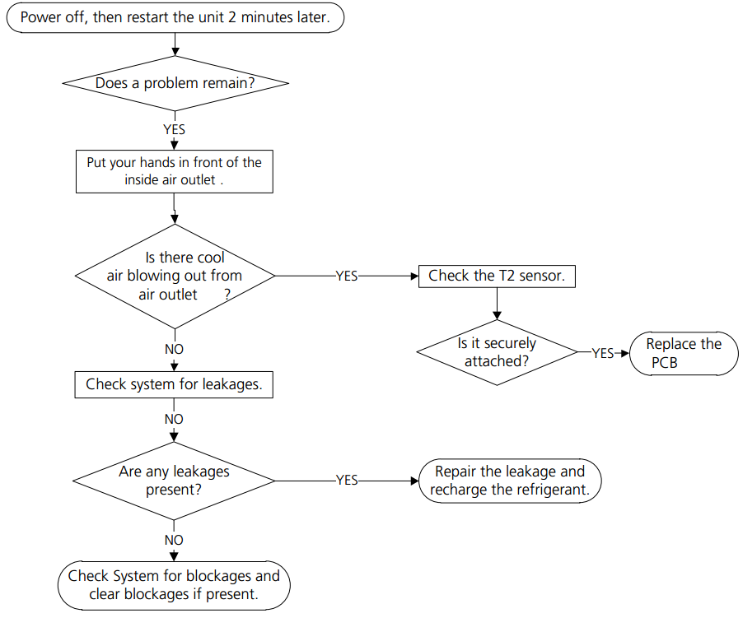
Leakage protection (EC)

Slide 5
Thanks!

